Slide 1


Cooperation
[Professor Name]
[Class and Section Number]
Notes:
Classroom Recommendations: This PowerPoint is designed to present this information over the course of one (75-minute) class. This information could be expanded to cover two days, if you add some activities from the Noba Instructor Manual or if you extend the amount of time in the current activities.
Overview: Humans are social animals. This means we work together in groups to achieve goals that benefit everyone. From building skyscrapers to delivering packages to remote island nations, modern life requires that people cooperate with one another. However, people are also motivated by self-interest, which often stands as an obstacle to effective cooperation. This module explores the concept of cooperation and the processes that both help and hinder it.
Technical Note: These slides may contain simple click animation so that you can focus students’ attention on a particular question, a selection of text, or an image and not have them be distracted by reading ahead. You can either preview the sequence of animation by going through the slides in slideshow view, visiting the animations tab, or reviewing the slide notes. In the notes you will see a cue - (Click) – that corresponds to each animation.
You may also find hyperlinks to outside videos at various places in the slides. These hyperlinks are embedded in text and indicated by color and in the notes section.

Slide 2
Learning Objectives
Explain the different types of social value orientation and how they affect cooperation.
Explain how empathy, communication, and trust impact cooperation.
Explain how group identification impacts cooperation.
Explain how culture affects cooperation.
Notes:
This slide outlines the learning objectives of the module.

Slide 3
Warmup: Ultimatum Game
Proposer
Responder
Proposer gets: | Responder gets:
$9 | $1
$8 | $2
$7 | $3
$6 | $4
$5 | $5
$4 | $6
$3 | $7
$2 | $8
$1 | $9
Notes:
This slide will help you with the Ultimatum Game Activity. This slide gives instructions to the proposers and the responders. More detailed instructions are below and in the Noba Instructor Manual.
(Click): Proposer
These are instructions for the proposers. Half of the class should be proposers (see below).
Read these instructions for the Proposer:
1) Imagine you have the following options to offer the responder.
You can provide handouts with the amounts on the slide. Or, if you are pressed for time, have them write their choice on a piece of paper.
2) If the responder accepts, you both get the amounts you propose.
It’s important for them to know the rules before they pick.
3) If the responder rejects, you both get $0.
It’s important for them to know the rules before they pick.
(Click): Responder
The other half of the class will be responders. After collecting the proposals from the proposers, randomly hand out proposals to the responders, in such a way that they do not know whose proposal they received
Read these instructions for the Responder:
1) If you accept, you (hypothetically) get the amounts offered.
Change this prompt is you are offering actual rewards.
2) If you reject, you both get $0.
Change this prompt is you are offering actual rewards.
Ultimatum Game Activity
Purpose: This activity gets students to play the ultimatum game, which illustrates some components of cooperation.
Time: 15-20 minutes
Materials: Handouts for half of your class with options for payouts. If pressed for time, you can have students pick on a piece of their paper that they turn in.
There is a slightly different version of this activity – including handouts – available as a link (click Activity 5 Guide.doc file) on http://www.fte.org/teacher-resources/lesson-plans/is-capitalism-good-for-the-poor/the-ultimatum-game/.
Other options include giving actual rewards to students. This could include candy or extra credit points. It could also be pennies instead of dollars, depending on the size of your class.
Randomly select half of the class to be proposers. They get to choose from the above options to anonymously propose to another student in class. They choose one of the 9 options. They are told that the responder can accept their proposal or reject the proposal. If accepted, rewards will be allocated as selected. If rejected, neither the proposer nor responder gets a reward.
If you are giving out actual rewards, you need some way to track the proposer and the responder. The proposer needs to stay anonymous from the responder, though. You could have the proposer write a code on their sheet (for example: the last two digits of their social security number, the first two letters of the town they were born in, the last two digits of their phone number) that can be tracked back to them later.
Collect the proposals from the proposers. Randomly hand out proposals to the responders, in such a way that they do not know whose proposal they received.
The other half of the class will be the responders. They choose whether to accept or reject the offer. Accepting means both the proposer and responder get the rewards. Rejecting means that neither get the rewards.
Discussion Question: What do you think the most common proposal is? Why?
This discussion will likely bring up some elements of cooperation and cooperative relationships. It may also bring up the issue of rational self-interest. As seen in http://www.fte.org/teacher-resources/lesson-plans/is-capitalism-good-for-the-poor/the-ultimatum-game/, the most common proposal is 50%-50%, which is $5/$5 in this example. The average proposal is 60%-40%, which is $6/$4 in this example.
Discussion Question: How many do you think are rejected by the responder?
This discussion question will also likely bring up issues of cooperation. The finding (see http://www.fte.org/teacher-resources/lesson-plans/is-capitalism-good-for-the-poor/the-ultimatum-game/) that 20% of low offers are rejected will bring up issues of rational self-interest. If people were operating under rational self-interest, they would accept all offers. However, 20% of the lowest offers are rejected, so there appear to be norms of cooperation that are influencing people’s behaviors.

Slide 4
Warmup: Ultimatum Game
What do you think the most common proposal is? Why?
How many do you think are rejected by the responder?
Proposer gets: | Responder gets:
$9 | $1
$8 | $2
$7 | $3
$6 | $4
$5 | $5
$4 | $6
$3 | $7
$2 | $8
$1 | $9
Notes:
This slide will help you with the Ultimatum Game Activity. This slide provides some discussion questions. More detailed instructions are below and in the Noba Instructor Manual.
(Click): What do you think the most common proposal is? Why?
This discussion will likely bring up some elements of cooperation and cooperative relationships. It may also bring up the issue of rational self-interest. As seen in http://www.fte.org/teacher-resources/lesson-plans/is-capitalism-good-for-the-poor/the-ultimatum-game/, the most common proposal is 50%-50%, which is $5/$5 in this example. The average proposal is 60%-40%, which is $6/$4 in this example.
(Click): How many do you think are rejected by the responder?
This discussion question will also likely bring up issues of cooperation. The finding (see http://www.fte.org/teacher-resources/lesson-plans/is-capitalism-good-for-the-poor/the-ultimatum-game/) that 20% of low offers are rejected will bring up issues of rational self-interest. If people were operating under rational self-interest, they would accept all offers. However, 20% of the lowest offers are rejected, so there appear to be norms of cooperation that are influencing people’s behaviors.
Ultimatum Game Activity
Purpose: This activity gets students to play the ultimatum game, which illustrates some components of cooperation.
Time: 15-20 minutes
Materials: Handouts for half of your class with options for payouts. If pressed for time, you can have students pick on a piece of their paper that they turn in.
There is a slightly different version of this activity – including handouts – available as a link (click Activity 5 Guide.doc file) on http://www.fte.org/teacher-resources/lesson-plans/is-capitalism-good-for-the-poor/the-ultimatum-game/.
Other options include giving actual rewards to students. This could include candy or extra credit points. It could also be pennies instead of dollars, depending on the size of your class.
Randomly select half of the class to be proposers. They get to choose from the above options to anonymously propose to another student in class. They choose one of the 9 options. They are told that the responder can accept their proposal or reject the proposal. If accepted, rewards will be allocated as selected. If rejected, neither the proposer nor responder gets a reward.
If you are giving out actual rewards, you need some way to track the proposer and the responder. The proposer needs to stay anonymous from the responder, though. You could have the proposer write a code on their sheet (for example: the last two digits of their social security number, the first two letters of the town they were born in, the last two digits of their phone number) that can be tracked back to them later.
Collect the proposals from the proposers. Randomly hand out proposals to the responders, in such a way that they do not know whose proposal they received.
The other half of the class will be the responders. They choose whether to accept or reject the offer. Accepting means both the proposer and responder get the rewards. Rejecting means that neither get the rewards.
Discussion Question: What do you think the most common proposal is? Why?
This discussion will likely bring up some elements of cooperation and cooperative relationships. It may also bring up the issue of rational self-interest. As seen in http://www.fte.org/teacher-resources/lesson-plans/is-capitalism-good-for-the-poor/the-ultimatum-game/, the most common proposal is 50%-50%, which is $5/$5 in this example. The average proposal is 60%-40%, which is $6/$4 in this example.
Discussion Question: How many do you think are rejected by the responder?
This discussion question will also likely bring up issues of cooperation. The finding (see http://www.fte.org/teacher-resources/lesson-plans/is-capitalism-good-for-the-poor/the-ultimatum-game/) that 20% of low offers are rejected will bring up issues of rational self-interest. If people were operating under rational self-interest, they would accept all offers. However, 20% of the lowest offers are rejected, so there appear to be norms of cooperation that are influencing people’s behaviors.

Slide 5
Overview
Prisoner’s Dilemma
  Rational Self-Interest
  Repeated Prisoner’s Dilemma
Individual Differences in Cooperation
Situational Influences of Cooperation
Culture
Notes:
The purpose of this slide is to provide students with an overview of the material that will be covered during the lecture

Slide 6

Prisoner’s Dilemma
Prisoner’s Dilemma Video
Rational self-interest
Repeated Prisoner’s Dilemma
Notes:
This slide introduces the prisoner’s dilemma.
(Click) Prisoner’s Dilemma
This is a link to a 5 minute, 44 second video (https://www.youtube.com/watch?v=t9Lo2fgxWHw) about the prisoner’s dilemma. This dilemma highlights the tension between choosing personal reward or choosing gains for the group. If someone is interested in personal rewards, the rational choice would be not to cooperate. If someone is interested in the gains for the group, then cooperating yields the highest combined reward. The video introduces the concept, gives an example of companies competing or cooperating, and discusses the idea of people being rational agents, which the modules discusses as rational self-interest.
(Click) Rational self-interest
Rational self-interest is the idea that people will always make choices that involve personal gain. However, many people cooperate during the prisoner’s dilemma, which would not be predicted by rational self-interest. If you did not talk about this when discussing the Ultimatum Game Activity, you might want to do so now. Rational self-interest also does not predict people’s behavior on the ultimatum game.
(Click) Repeated Prisoner’s Dilemma
Purpose: This activity illustrates the prisoner’s dilemma. In addition, it illustrates the repeated or iterated prisoner’s dilemma (not discussed in the module).
Materials: Computer with internet connection
Time: 5-10 minutes
The link on the slide goes to: http://www.gametheory.net/Mike/applets/PDilemma/Pdilemma.html
This activity can be completed in class, as the instructor plays in front of the class (with student input). It could also be given as part of an assignment for students to complete outside of class.
This demonstration allows you to play 25 rounds each against 5 different opponents. Not all opponents play alike, and playing each of the 5 opponents can illustrate what happens when 1) you as a player use different strategies, and 2) your opponent uses different strategies. Overall rewards can be compared after playing all 5 opponents.
In discussing the activity, it would be nice to highlight issues from the modules such as communication and trust. This activity also allows you to discuss how cooperation may be different with people we expect to need to cooperate with in the future versus strangers we will never see again.

Slide 7
Overview
Prisoner’s Dilemma
Individual Differences in Cooperation
  Social Value Orientation
  Empathic Ability
Situational Influences of Cooperation
Culture
Notes:
The purpose of this slide is to provide students with an overview of the material that will be covered next.

Slide 8
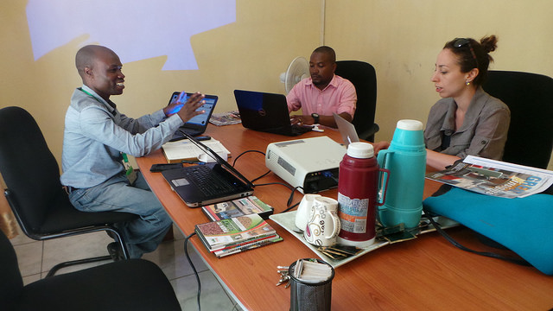
Individual Differences in Cooperation
Social Value Orientation
  Cooperative
  Individualistic
  Competitive
Notes:
This slide highlights the individual differences in cooperation by introducing social value orientation.
(Click) Social Value Orientation
Social value orientation (SVO) describes a person’s general tendencies when dividing resources between themselves and others. There are three categories of SVO.
(Click) Cooperative
A person with a cooperative SVO desires positive outcomes for all. They will usually pick the most cooperative option.
(Click) Individualistic
A person with an individualistic SVO is most concerned about their own outcomes. They are less concerned by others’ outcomes. They will be most likely to pick the outcome that benefits them the most.
(Click) Competitive
A person with a competitive SVO wants to undermine others’ outcomes. They will likely pick the option that disadvantages others.

Slide 9
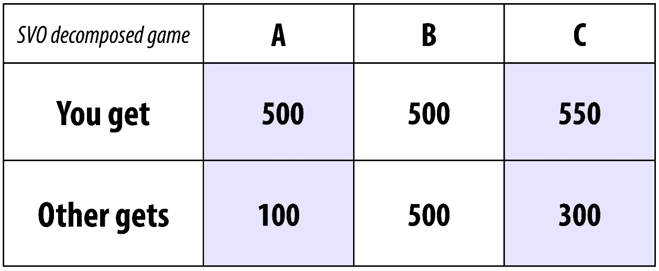
Individual Differences in Cooperation
Which option would someone with a cooperative SVO choose?
An individualistic SVO?
A competitive SVO?
Notes:
This slide examines Figure 2 from the module, showing a decomposed game illustrating social value orientation
(Click) Which option would someone with a cooperative SVO choose?
They would be most likely to choose B, which is the most cooperative answer.
(Click) An individualistic SVO?
They would be most likely to pick C, which give them the highest reward.
(Click) A competitive SVO?
They would be most likely to pick A, which give the other person the lowest reward.
Note: Other examples of this decomposed game (with differing amounts of money) can be found at http://fetzer.org/sites/default/files/images/stories/pdf/selfmeasures/PROSOCIAL-SOCIALVALUESORIENTATION.pdf

Slide 10
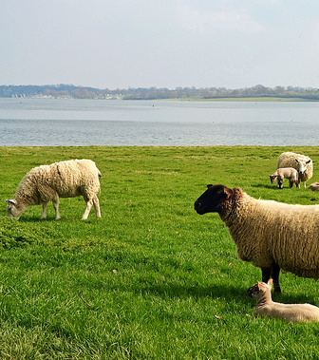
Individual Differences in Cooperation
Common’s Dilemma Video
  And SVO
Tragedy of the Anticommons
Notes:
This slide introduces the common’s dilemma.
(Click) Common’s Dilemma
A commons dilemma game mimics a common-pool resource for the group. Such a resource, such as farm land or ground water) remains available for everyone if individuals don’t overuse the resource. If people take too much of the resource, it can eventually deplete it. It was named common’s dilemma from a time when people would let their animals graze on the town commons. This link (https://www.youtube.com/watch?v=KZDjPnzoge0) goes to a 1 minute, 51 second video that gives some concrete examples of the commons dilemma.
(Click) And SVO
A person’s SVO can predict how they will solve a commons dilemma game. People with a cooperative SVO tend to take less of a common-pool resource than those with a cooperative or individualistic SVO. People with a cooperative SVO are also more likely to use public transportation, volunteer, and give money to charity.
(Click) Tragedy of the Anticommons
A common-pool resource dilemma is sometimes referred to as tragedy of the commons, the idea that a common resource is at a high risk for depletion if every person overuses it without being concerned about conserving it or sharing it with others. The flip side of this phenomenon is referred to as the tragedy of the anticommons, the idea that there are some resources which only a few individuals use and have access to and where making that resource available to many others would lead to vast societal benefits. Examples of such resources include data (some scientists are reluctant to share their data even when their research is tax-payer funded), or patents (which may have several owners, with each having the power to restrict the other’s use of it, which leads to no one being able to use the resource in the end). For more information on this topic, please visit:
https://en.wikipedia.org/wiki/Tragedy_of_the_anticommons
And Noba module – Replication Crisis: http://noba.to/q4cvydeh

Slide 11

Individual Differences in Cooperation
Empathic Ability
Notes:
This slide highlights the individual differences in cooperation by introducing empathy.
Empathic Ability
Empathy is “the ability to feel and understand another’s emotional experience.” Empathy is taking the perspective of another person. When people empathize with a partner, then they are more likely to be cooperative and engage in altruism, a “the desire to help the partner, even at potential cost to the self.” In experimental studies, participants who were encouraged to be empathetic with a person were more likely to be cooperative with that person than participants who were told to remain objective.

Slide 12
Overview
Prisoner’s Dilemma
Individual Differences in Cooperation
Situational Influences of Cooperation
  Communication and Commitment
  Trust
  Group Identification
Culture
Notes:
The purpose of this slide is to provide students with an overview of the material that will be covered next.

Slide 13

Situational Influences of Cooperation
Communication and Commitment
Trust
Group Identification
  Social Identity
Notes:
This slide highlights the situational influences of cooperation.
(Click): Communication and Commitment
Open communication can promote cooperation. Cooperation includes a state of vulnerability in which a person could be exploited or harmed. Further, people who make commitments to cooperate with others during communication tend to follow through on those commitments.
(Click): Trust
Cooperating with others requires trust that others will follow through and not act in a self-interested manner. Students’ group projects highlight some of the issues with trust, especially with respect to social loafing and the free rider problem, when individuals benefit from the group while contributing little or nothing. However, a free rider will earn a reputation for not cooperating, which makes it less likely that others will cooperate with that person in the future. Meanwhile, people will likely cooperate with individuals who have a reputation for cooperating, even earning higher rewards in experimental studies.
(Click): Group identification
A person’s group identification can affect their level of cooperation.
(Click): Social Identity
A person’s social identity, or how much they identify with a social group, can impact their cooperative behavior. The groups that people belong to that they highly value can affect their identity, their view of themselves. As a result, their identity is shaped in part by what the group values. People who identify with a group are more likely to be cooperative and make sacrifices for the group’s benefit.

Slide 14
Overview
Prisoner’s Dilemma
Individual Differences in Cooperation
Situational Influences of Cooperation
  Communication and Commitment
  Trust
  Group Identification
Culture
Notes:
The purpose of this slide is to provide students with an overview of the material that will be covered next.

Slide 15

Culture
Culture and Cooperation
Notes:
This slide introduces the topic of culture and cooperation.
(Click): Culture and Cooperation
Culture very likely affects people’s cooperative behavior. A study using the ultimatum game, similar to the prisoner’s dilemma, was conducted in 15 different societies. Overall, people in all cultures seemed to maintain a sense of fairness during the game. There were, however, some differences in how much people cooperated across cultures. People from cultures where interdependence was a key to survival were more likely to cooperate than people from cultures that were industrialized and more independent.
Reference:
Henrich, J., Boyd, R., Bowles, S., Camerer, C., Fehr, E., Gintis, H., & McElreath, R. (2001). In search of homo economicus: Behavioral experiments in 15 small-scale societies. The American Economic Review, 91(2), 73-78.

Slide 16

CAT: One-Minute Paper
What was the most important thing you learned during this class?
What important question remains unanswered?
Notes:
Classroom Assessment Technique (CAT): One-Minute Paper
If you are presenting the information on one class day, you might end the material about here. End your class time with a one-minute paper.
The Minute Paper tests how students are gaining knowledge, or not. The instructor ends class by asking students to write a brief response to the following questions: “What was the most important thing you learned during this class?” and “What important question remains unanswered?”
Have students briefly answer these questions in writing and turn them in. After class, assess students’ responses. At the beginning of the next class, go over any misunderstandings or relevant questions.
If you do not conclude with this Classroom Assessment Technique (CAT), it would helpful to use another CAT. It could be in the form of a:
Muddy point
One-minute paper
Background knowledge
What’s the Principle?
Defining features Matrix:
For more information on CATs click here: http://cft.vanderbilt.edu/guides-sub-pages/cats/

Slide 17
Photo Attribution
Slide 1 | Photo Credit: Connect PublicDomainPictures https://pixabay.com/en/connect-connection-cooperation-316638/ https://creativecommons.org/publicdomain/zero/1.0/deed.en
Slide 6 | Photo Credit: Happy girl Tax Credits https://www.flickr.com/photos/76657755@N04/7658182562 https://creativecommons.org/licenses/by/2.0/
Slide 8 | Photo Credit: ECDPM mission to DRC, Malawi and Lusaka European Centre for Development Policy Management https://www.flickr.com/photos/26947525@N02/25042359893/ https://creativecommons.org/licenses/by-nc-sa/2.0/
Slide 9 | Image Credit: SVO Decomposed Game Noba Staff https://creativecommons.org/licenses/by-nc-sa/4.0/deed.en_US
Slide 10 | Photo Credit: Grazing Dun.can https://www.flickr.com/photos/duncanh1/17178753398 https://creativecommons.org/licenses/by/2.0/
Slide 11 | Photo Credit: we are the world Leo Grübler https://www.flickr.com/photos/leo-gruebler/6347903993 https://creativecommons.org/licenses/by-nd/2.0/
Slide 13 | Photo Credit: Paperback Book vs. Amazon Kindle Megan Trace https://www.flickr.com/photos/megantrace/6201381800 https://creativecommons.org/licenses/by-nc/2.0/
Slide 14 | Photo Credit: Untitled Keira Morgan https://www.flickr.com/photos/keiramellis/5921717863 https://creativecommons.org/licenses/by-nc/2.0/
Slide 15 | Photo Credit: Multi-Ethnic Diverse Group of People In Circle Concept @GwynethJones -The Daring Librarian! https://www.flickr.com/photos/43666171@N07/24277450136/ https://creativecommons.org/licenses/by-nc-sa/2.0/
Slide 16 | Photo Credit: Illustrated silhouette of a black cat nehtaeh79 http://www.freestockphotos.biz/stockphoto/16624 http://creativecommons.org/publicdomain/zero/1.0/
Notes:
Photo Attribution Slide

